Slide 1
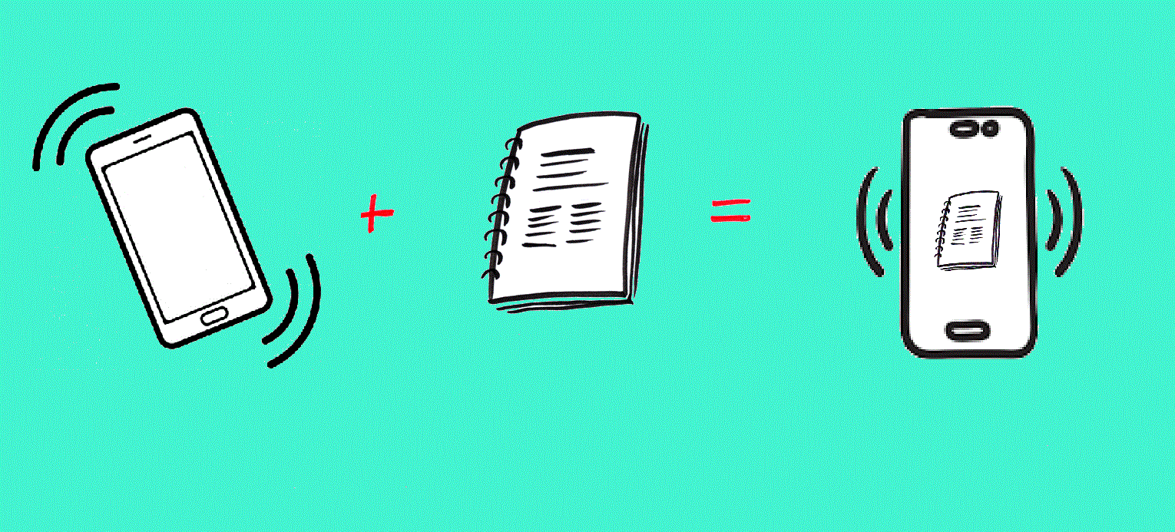
MOBINOTES - LEARN AND SHARE
DEVELOPED BY-
Subho Chakraborty
Manisha Kumari
Sangeeta Mohapatro
Saloni Priya
GROUP - WiNS

Slide 2

OBJECTIVE
To customize the way of studying and sharing.
To provide free online study tool that makes it easier to record and organise every students' ideas, then share them whenever and with whomever they like.
ALLPPT.com _ Free PowerPoint Templates, Diagrams and Charts

Slide 3

INTRODUCTION
Gone are those days where students used to study throughtout the year for the exam.In the present day senario, we students always do the last minute preparations for exam.
Mobinotes mainly aims at providing all the required materials essential for a student to prepare well for his exam.
Not only this it also provides a free platform for the students as well as the faculties to share their ideas.
It’s a free online study tool that makes it easier than ever to record and organise your ideas, then share them whenever you like,with whomever they like.

Slide 4

FEATURES
Students can sign-up using their college id.
Every college will have its own repository.
Students can filter out notes related to their study domain.
They can create a group of their own, where they can study and share relative contents.
sharing and uploading of notes
the members can have conference voice calls and screen sharing
Students from a particular group in the app can invite faculty/professors to help them while in hostel through the voice lobby and screen sharing lobby.

Slide 5
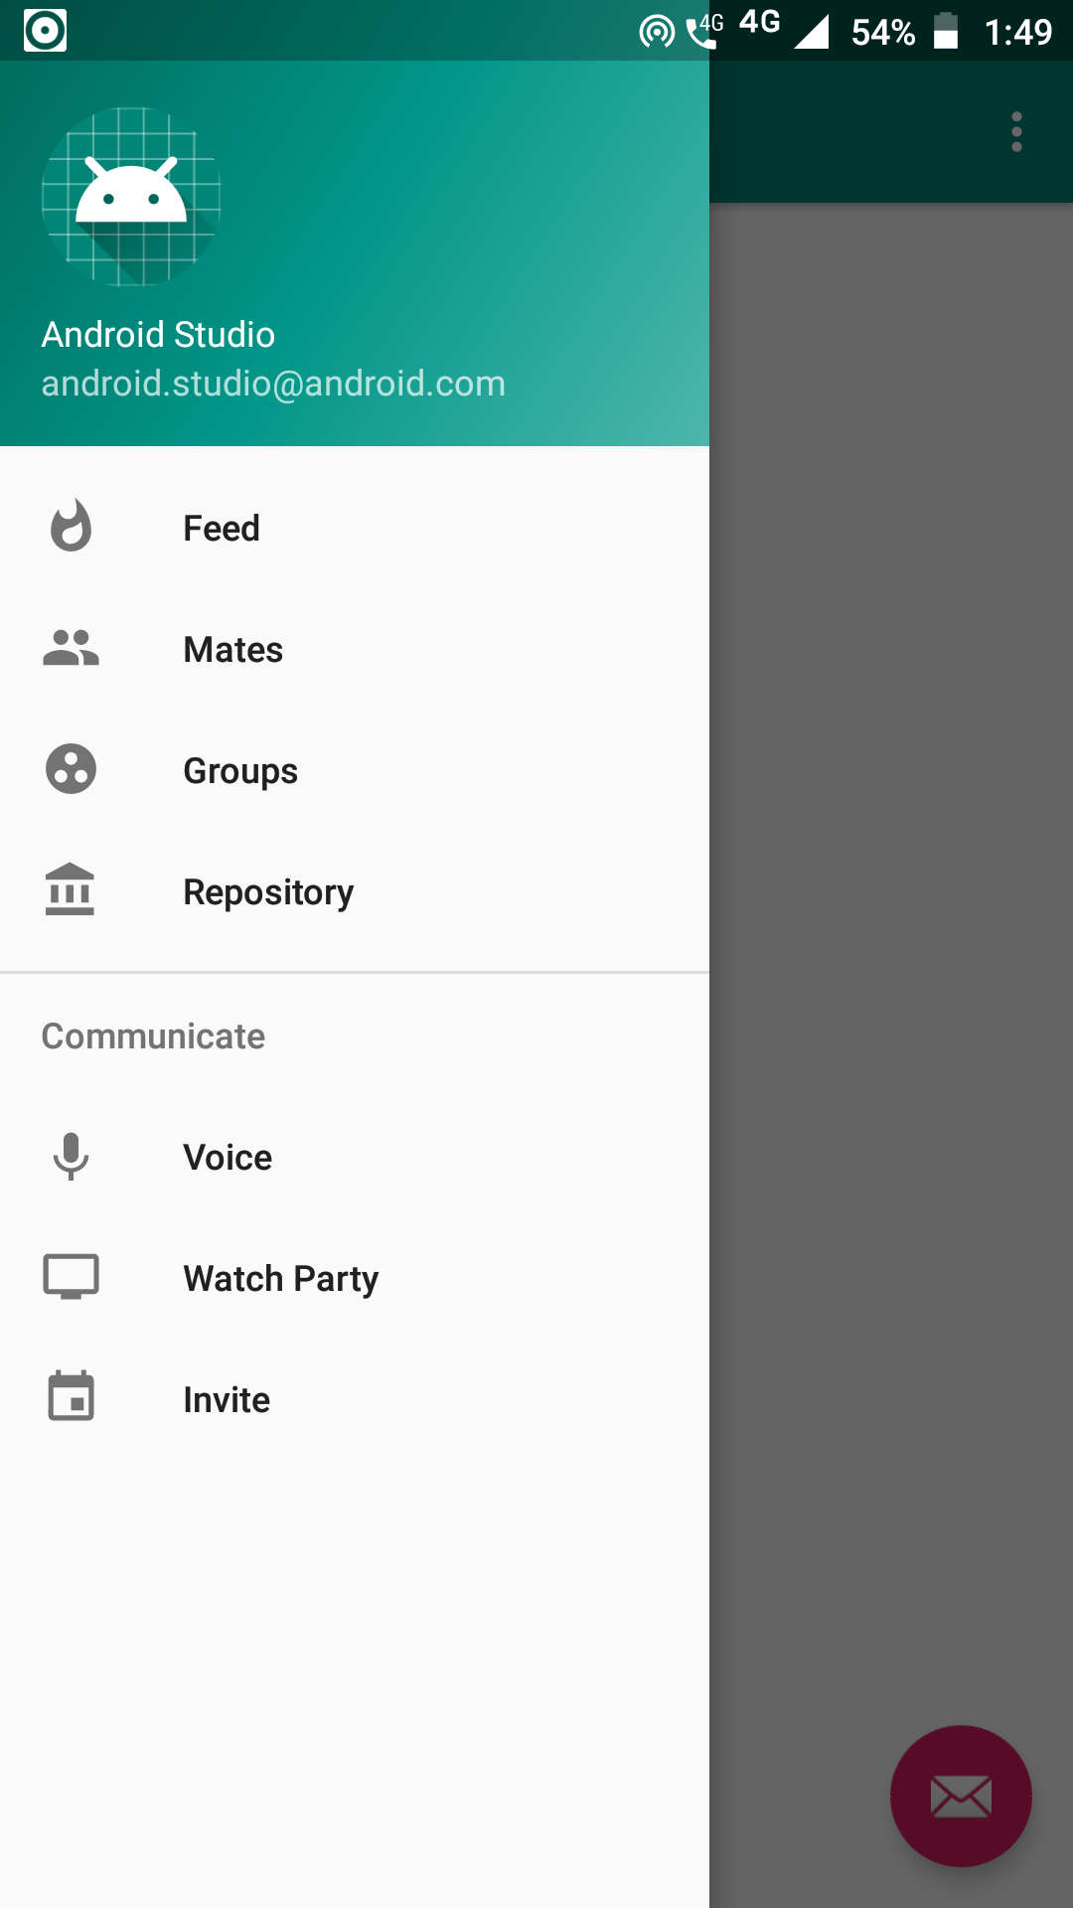
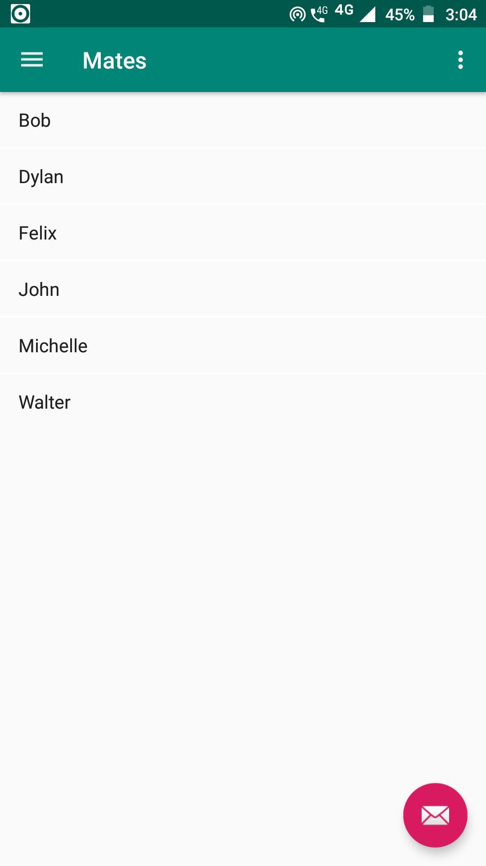
menu
←
mates or
people
added
→

Slide 6
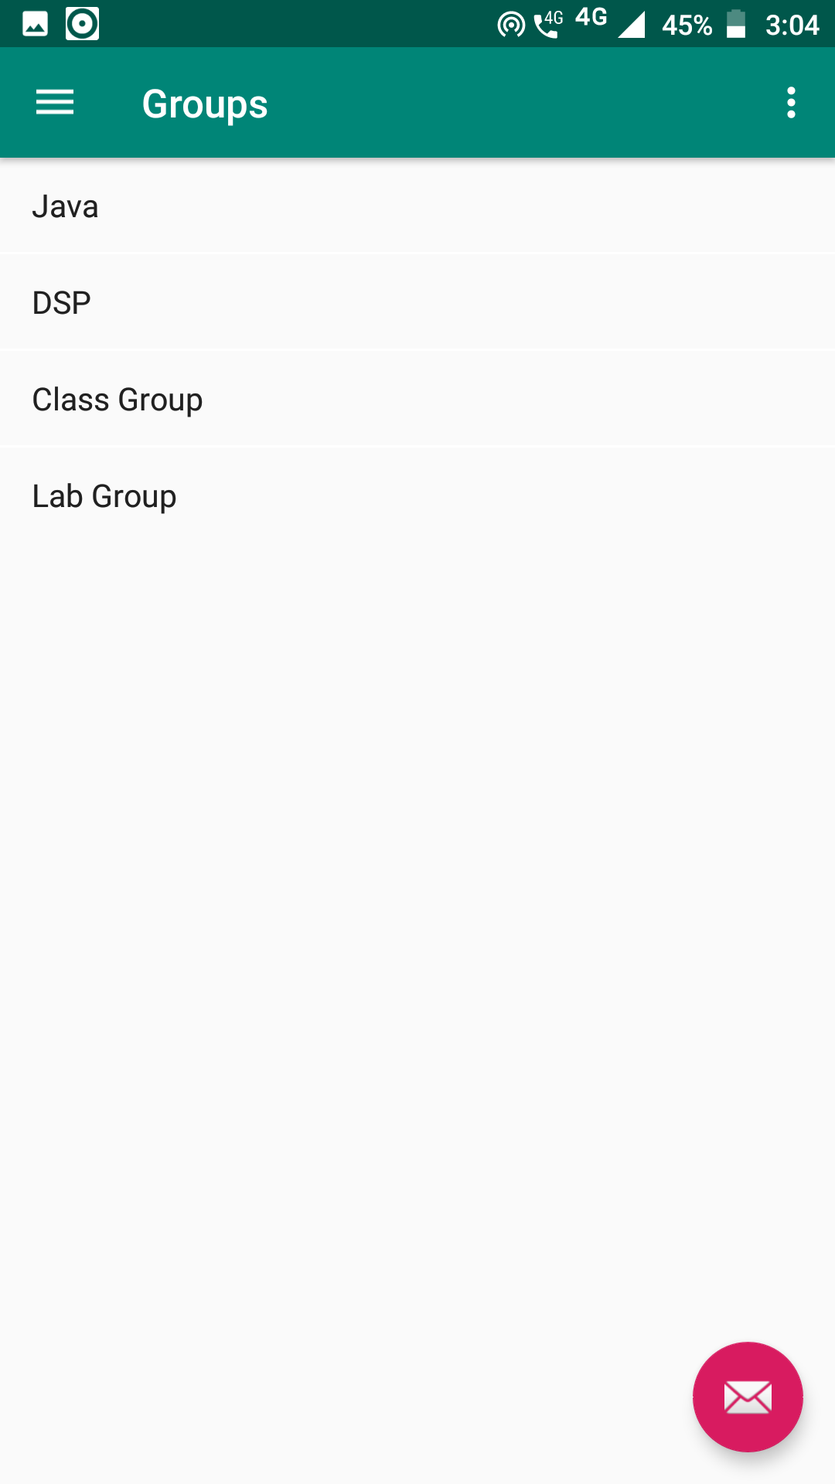
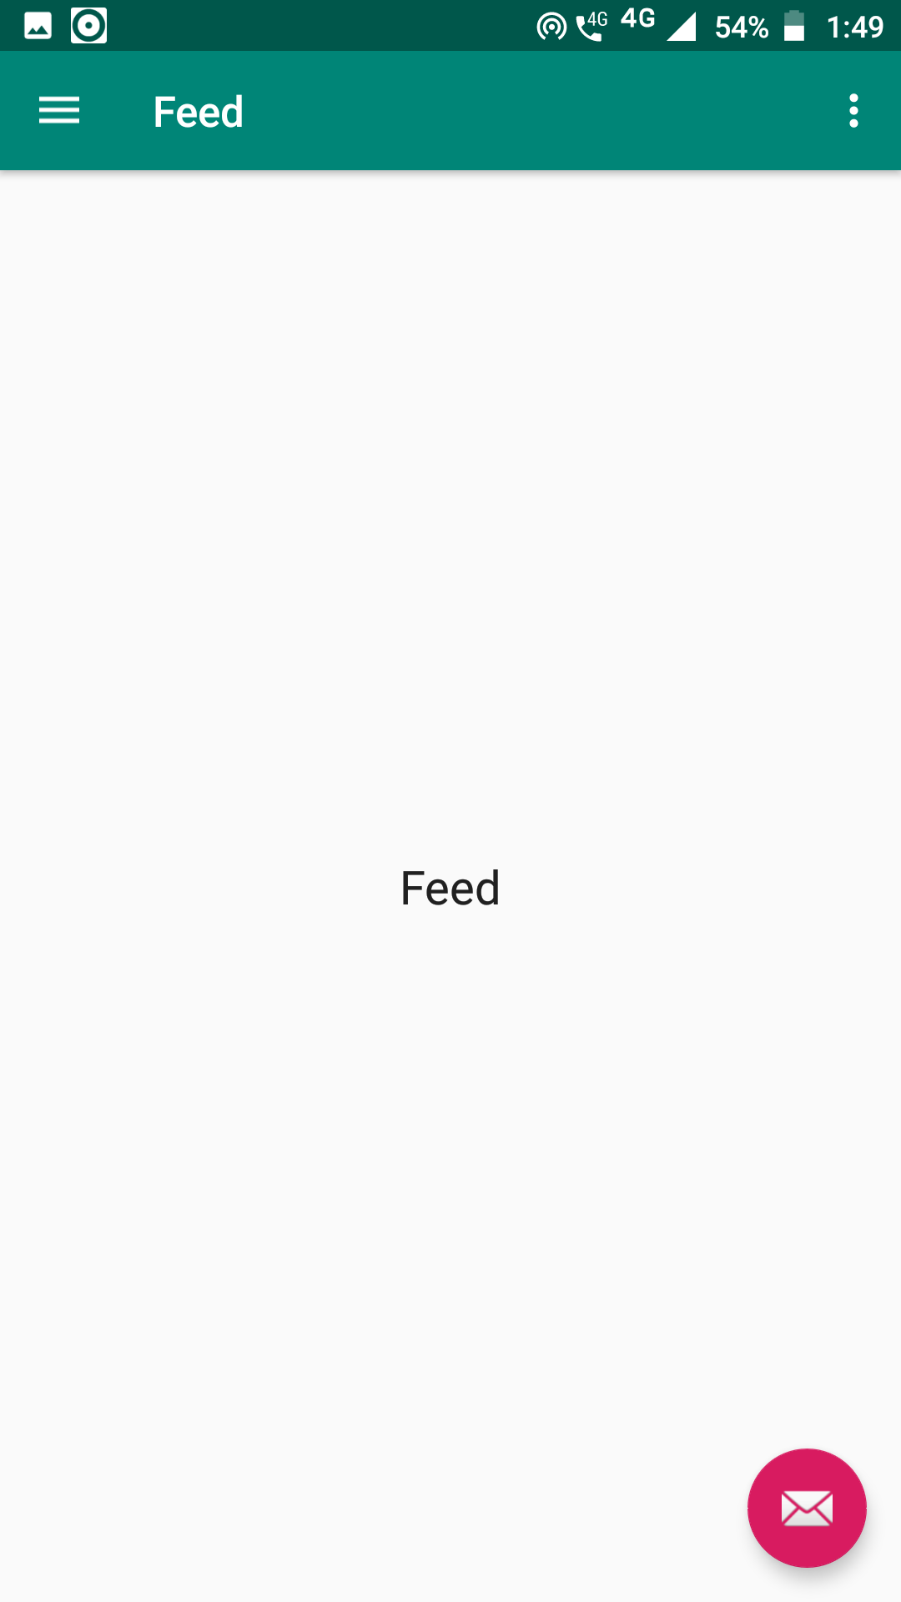
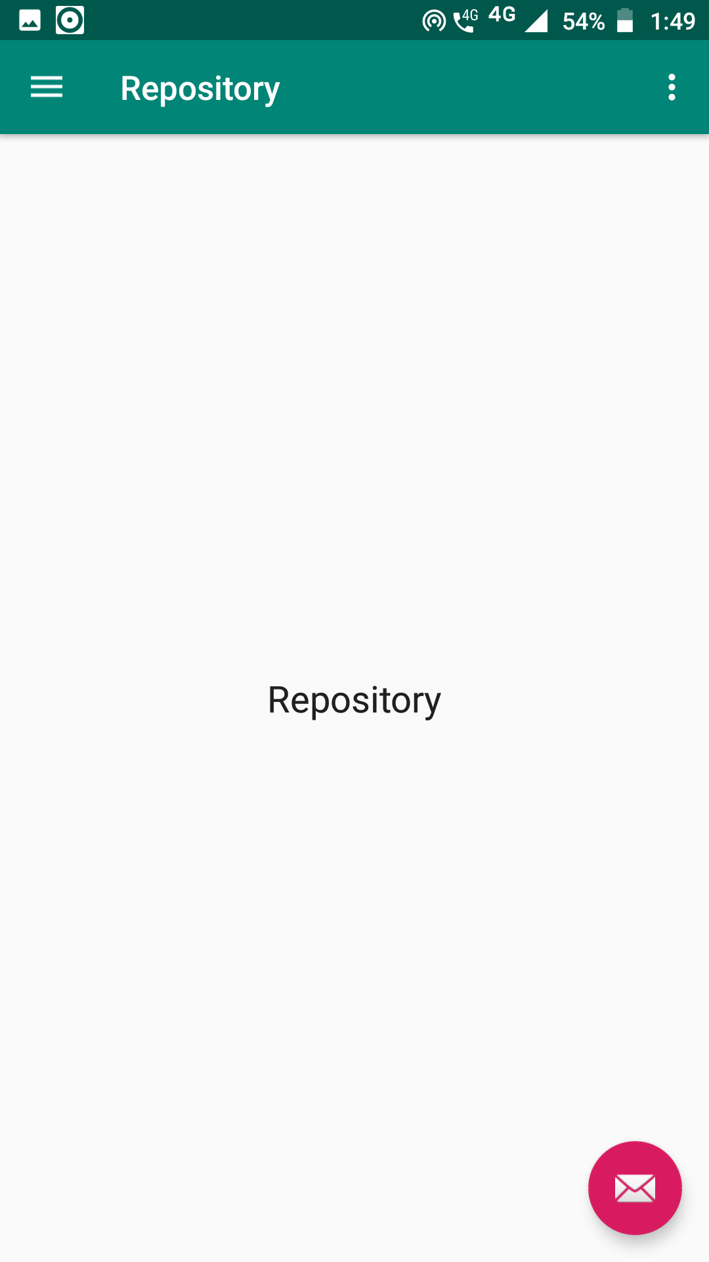

Slide 7
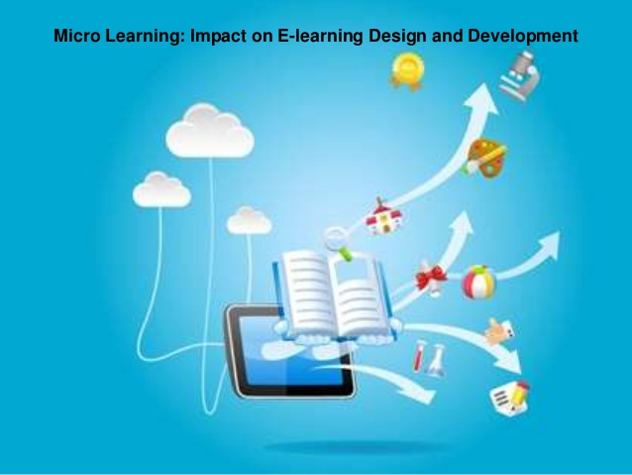
ADVANTAGES
Allows teachers to create an exciting way to educate studets.
More secure.
24x7 availibility.
filling in the gaps.
instant updates.
allows faculty to interact through invite links.

Slide 8

WEAKNESS
maximum 5 students can have a group call only.
people other than the particular college cannot use it.

Slide 9

THREATS
Unintended data leakage.
Improper session handling.

Slide 10

CONCLUSION
Technology alone will not improve education, but it can be a powerful part of the solution.Technology is transforming teaching and learning. It’s helping children learn at their own pace, become creative problem solvers and effective collaborators. But for those without access, existing learning gaps are only widening. That's why we’ll continue directing our products, people, programmes and philanthropy toward a future where every student has access to the skills they need and the quality education they deserve.

Slide 11
THANK YOU

